Slide 1
Digital Portfolio
STUDENT NAME: Vijaya Bharathi.V
REGISTER NO AND NMID: asunm1451222407533
DEPARTMENT: B.Sc Computer Science
COLLEGE: Mahalashmi women’s college of arts and science
Madras University

Slide 2
PROJECT TITLE
DIGITAL PORTFOLIO

Slide 3


AGENDA
Problem Statement
Project Overview
End Users
Tools and Technologies
Portfolio design and Layout
Features and Functionality
Results and Screenshots
Conclusion
Github Link
3/21/2024 Annual Review

Slide 4

PROBLEM STATEMENT
The Digital Portfolio project aims to create a professional online space that highlights my academic journey, technical expertise, and personal achievements. Its purpose is to present my skills and projects in a structured and visually engaging manner, making it easier for educators, recruiters, and peers to understand my strengths. By integrating academic records, technical works, certifications, and career aspirations, this portfolio serves as both a learning reflection and a tool for future opportunities in the field

Slide 5

PROJECT OVERVIEW
The Digital Portfolio Project is designed to showcase my academic achievements, technical skills, creative works, and professional experiences in an organized and interactive way. This portfolio acts as a personal brand identity and a central hub for presenting my growth, learning journey, and career goals.

Slide 6

WHO ARE THE END USERS?
Digital portfolios cater to various end users like employers, clients, educators, peers, and investors, showcasing skills, work, and achievements. Key types include professional, creative, and academic portfolios, focusing on visual appeal, easy navigation, and relevant content tailored to the audience.

Slide 7

TOOLS AND TECHNIQUES
Digital portfolios effectively showcase skills, work, and achievements to key audiences like employers, clients, and educators, blending strong presentation with tailored content.
Main Points
*Portfolio Types*:
Professional (career skills), Creative (artistic/design work), Academic (research/achievements).- *Core Features*:
Engaging visual design, easy navigation, audience-relevant content.
*Creation Tools*:
Wix, Squarespace, Adobe Creative Cloud, Behance, Dribbble.-

Slide 8
POTFOLIO DESIGN AND LAYOUT
Digital portfolio design and layout are crucial for effectively showcasing work. Here's a balanced view:Core Aspects- *Visual Appeal*: Engaging design, quality imagery, balanced use of whitespace.
*Responsiveness*: Works well on desktop, mobile, tablet.-
*Navigation*: Easy to explore, intuitive menus.- *Content Focus*: Highlights best, relevant work samples.- *Branding*: Consistent with personal or company identity.
Layout
Approaches1. *Grids*: Organizes work visually.
2. *Scrolling Designs*: Compact showcase.
3. *Project Highlights*: Dedicated sections for key projects.
Considerations- Tailor design to target audience (employers, clients).
8

Slide 9
FEATURES AND FUNCTIONALITY
Digital portfolios showcase work, skills, and achievements with key features like responsive design, easy navigation, visual appeal, and curated content. They enable audience engagement, professional branding, and effective communication of strengths to employers, clients, or peers. Core functionalities include showcasing skills, interaction, and online presence.

Slide 10
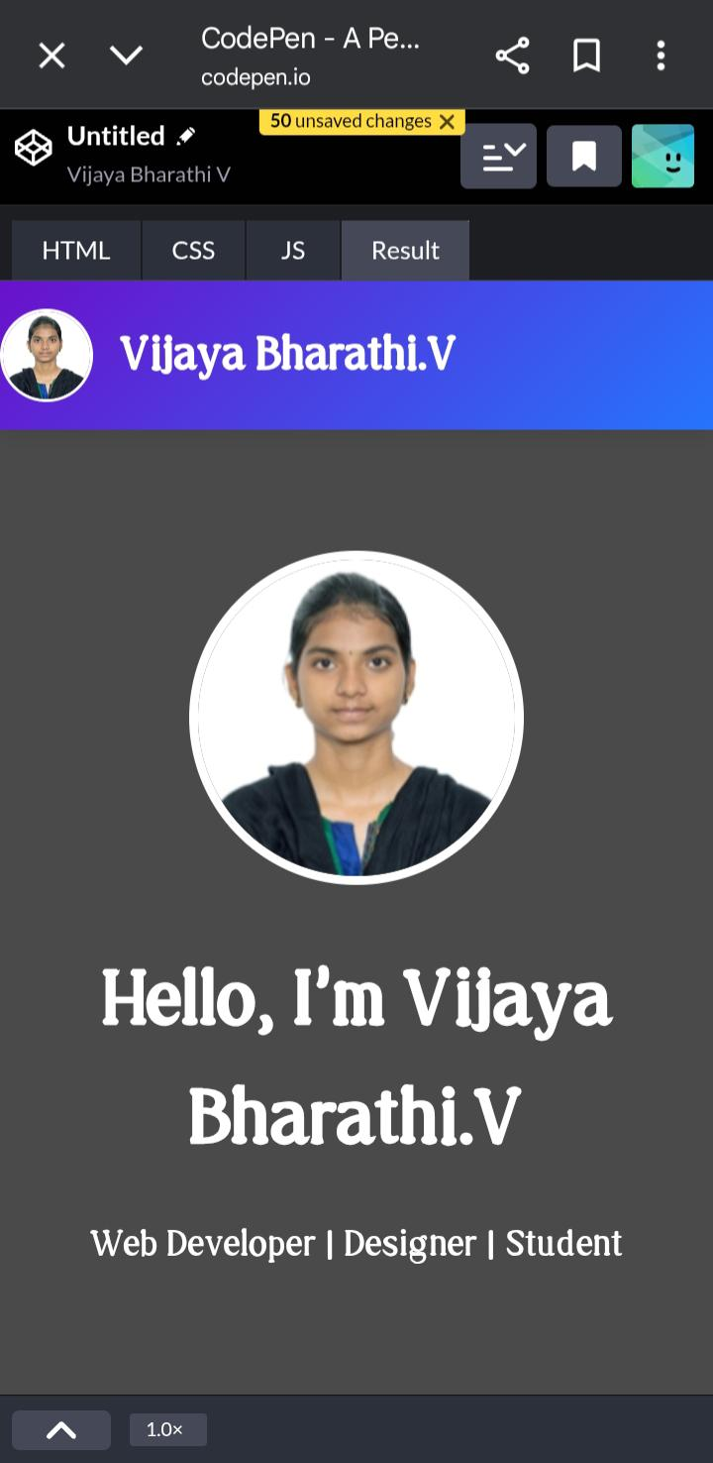

RESULTS AND SCREENSHOTS
Digital portfolio is an online showcase of skills, work, and achievements. Benefits include showcasing capabilities, dynamic engagement, easy sharing/updating. Platforms like Wix, Squarespace, Behance help create them. Tailor content to audience, keep it clean and responsive.
3/21/2024 Annual Review
10

Slide 11
CONCLUSION
A digital portfolio is a powerful online tool showcasing skills, work, and achievements, enhancing professional visibility and opportunities. It offers dynamic presentation, easy updates, and audience engagement, tailored to target viewers like employers or clients. Effective digital portfolios blend compelling design, curated content, and functionality, communicating strengths clearly in professional, creative, or academic contexts.
11

